Slide 1
ERD to Class

Slide 2
Example Scenario
The University of Toronto has several departments. Each department is managed by a chair, and at least one professor. Professors must be assigned to one, but possibly more departments. At least one professor teaches each course, but a professor may be on sabbatical and not teach any course. Each course may be taught more than once by different professors. We know of the department name, the professor name, the professor employee id, the course names, the course schedule, the term/year that the course is taught, the departments the professor is assigned to, the department that offers the course.

Slide 3
Entity/Class Candidates
departments,
chair,
professor,
course, and
course section

Slide 4
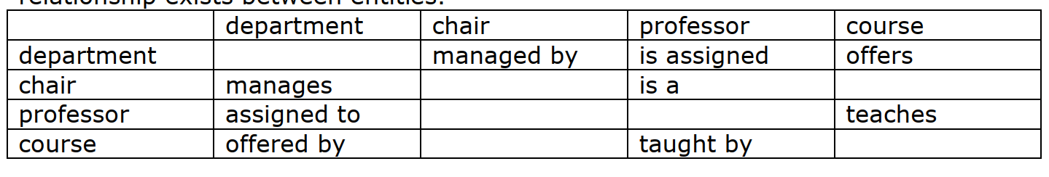
Finding Relationship

Slide 5
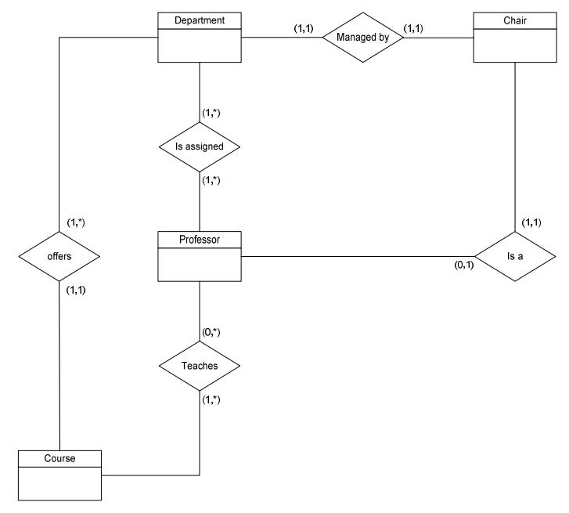

Slide 6
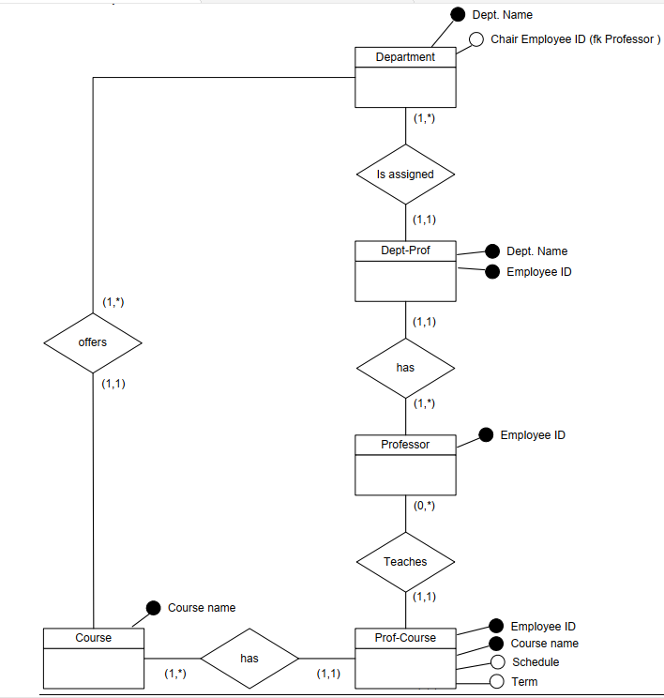

Slide 7
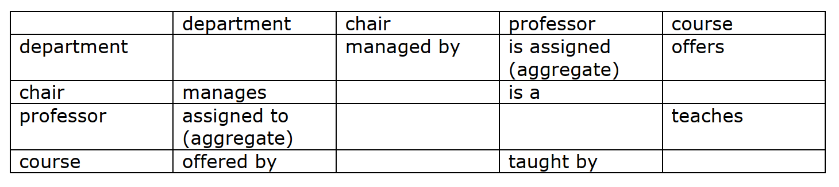
Finding Association

Slide 8
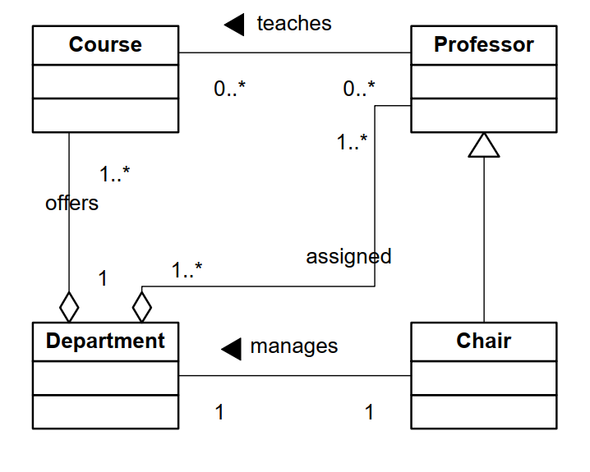
Basic Class Diagram

Slide 9
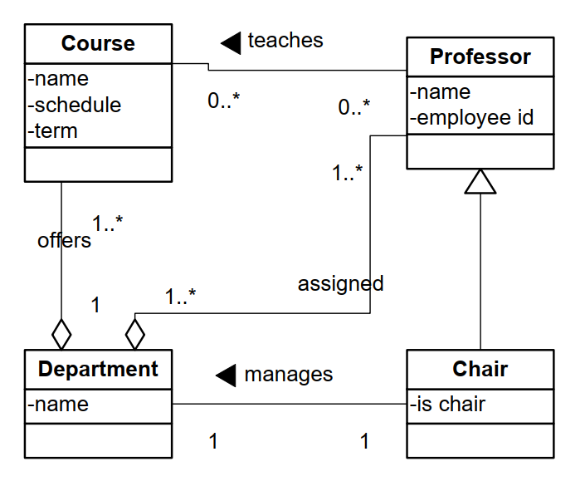
Adding Attributes

Slide 10
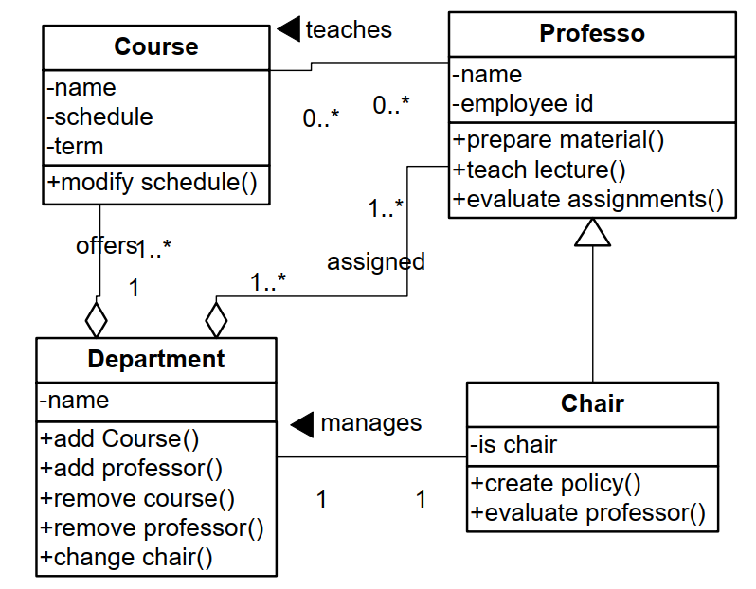
Operations/behaviors of a class

